Slide 1
Digital Circuit Design
18B11EC215
Lecture 9
Karnaugh Map Simplification

Slide 2
Outline
Converting to minterms form
SOP Expressions
POS Expressions
Don’t Care Conditions

Slide 3
Converting to Minterms Form
The K-map of a function is easily drawn when the function is given in canonical sum-of-products, or sum-of-minterms form.
What if the function is not in sum-of-minterms?
  Convert it to sum-of-products (SOP) form.
  Expand the SOP expression into sum-of-minterms expression, or fill in the K-map directly based on the SOP expression.

Slide 4
Simplification Using K-maps
Larger groups correspond to product terms of fewer literals. In the case of a 4-variable K-map:
1 cell = 4 literals, e.g.: w.x.y.z, w'.x.y'.z
2 cells = 3 literals, e.g.: w.x.y, w.y'.z'
4 cells = 2 literals, e.g.: w.x, x'.y
8 cells = 1 literal, e.g.: w, y', z
16 cells = no literal, e.g.: 1

Slide 5
Simplification Using K-maps
Other possible valid groupings of a 4-variable K-map include:
1
1
1
1
1
1
1
1
1
1
1
1
1
1
1
1
1
1
1
1




Slide 6
Simplification Using K-maps
Groups of minterms must be
(1) rectangular, and
(2) have size in powers of 2’s.
Otherwise they are invalid groups. Some examples of invalid groups:
1
1
1
1
1
1
1
1
1
1
1
1
1
1
1
1



Slide 7
Example
Simplify the Boolean function
F(w, x, y, z) = ∑(0, 1, 2, 4, 5, 6, 8, 9, 12, 13, 14)
y
yz
00 01 11 10
wx
00 01
11
10
1
1
1
1
1
1
1
1
1
1
1
1
1
1
x
1
1
1
w
1
1
z

Slide 8
Example
F(w, x, y, z) = (0, 1, 2, 4, 5, 6, 8, 9, 12, 13, 14)
F = y’ + w’z’ + xz’
y
yz
00 01 11 10
wx
00 01
11
10
1
1
1
1
1
1
1
1
1
1
1
1
1
1
x
1
1
1
w
1
1
z

Slide 9
Simplest SOP Expressions
To find the simplest possible sum of products (SOP) expression from a K-map, you need to obtain:
  minimum number of literals per product term; and
  minimum number of product terms
This is achieved in K-map using
  bigger groupings of minterms (prime implicants) where possible; and
  no redundant groupings (look for essential prime implicants)
Implicant: a product term that could be used
to cover minterms of the function.

Slide 10
Simplest SOP Expressions
A prime implicant is a product term obtained by combining the maximum possible number of minterms from adjacent squares in the map.
Use bigger groupings (prime implicants) where possible.
1
1
1
1
1
1
1
1
1

1
1
1


Slide 11
Simplest SOP Expressions
No redundant groups:
An essential prime implicant is a prime implicant that includes at least one minterm that is not covered by any other prime implicant.
1
1
1
1
1
1

1
1

1
1
1
1
1
1
1
1
Essential prime implicants

Slide 12
Simplest SOP Expressions
Algorithm :
  1. Circle all prime implicants on the K-map.
  2. Identify and select all essential prime implicants for the cover.
  3. Select a minimum subset of the remaining prime implicants to complete the cover, that is, to cover those minterms not covered by the essential prime implicants.

Slide 13
Examples
Example #1:
f(A,B,C,D) = ∑ m(2,3,4,5,7,8,10,13,15)
A
AB
CD
00 01 11 10
00
01
11
10
1
1
Fill in the 1’s.
1
1
D
1
1
1
C
1
1
B

Slide 14
Examples
Example #1:
f(A,B,C,D) = ∑ m(2,3,4,5,7,8,10,13,15)
A
AB
CD
00 01 11 10
These are all the prime implicants; but do we need them all?
00
01
11
10
1
1
1
1
D
1
1
1
C
1
1
B

Slide 15
Examples
Example #1:
f(A,B,C,D) = ∑ m(2,3,4,5,7,8,10,13,15)
A
AB
CD
00 01 11 10
00
01
11
10
1
1
Essential prime implicants:
B.D
A'.B.C'
A.B'.D'
1
1
D
1
1
1
C
1
1
B

Slide 16
Examples
Example #1:
f(A,B,C,D) = ∑ m(2,3,4,5,7,8,10,13,15)
A
AB
CD
00 01 11 10
00
01
11
10
1
1
Minimum cover.
EPIs: B.D, A'.B.C', A.B'.D'
+
A'.B'.C
1
1
D
1
1
1
C
1
1
B
f(A,B,C,D) = B.D + A'.B.C' + A.B'.D' + A'.B'.C

Slide 17
Examples
AB
A
A
CD
00 01 11 10
AB
00
01
11
10
CD
00 01 11 10
1
1
Essential prime implicants
00
01
11
10
1
1
1
1
D
1
1
1
1
1
C
D
1
1
1
1
1
C
B
1
1
SUMMARY
A
B
AB
CD
00 01 11 10
00
01
11
10
1
1
Minimum cover
1
1
D
1
1
1
C
1
1
f(A,B,C,D) = B.D + A'.B'.C + A.B'.D' + A'.B.C'
B

Slide 18
Examples
Example #2:
f(A,B,C,D) = A.B.C + B'.C.D' + A.D + B'.C'.D'
A
AB
CD
00 01 11 10
00
01
11
10
1
1
Fill in the 1’s.
1
1
D
1
1
C
1
1
1
B

Slide 19
Examples
Example #2:
f(A,B,C,D) = A.B.C + B'.C.D' + A.D + B'.C'.D'
A
AB
CD
00 01 11 10
00
01
11
10
1
1
Find all PIs:
A.D
A.C
B'.D'
1
1
D
1
1
C
1
1
1
B
Are all ‘1’s covered by the PIs? Yes, so the answer is: f(A,B,C,D) = A.D + A.C + B'.D'

Slide 20
Getting POS Expressions
Simplified POS expression can be obtained by grouping the maxterms (i.e. 0s) of given function.
Example:
Given F=ΠM(4,6,12,13,14,15), draw the K-map and write reduced maxterm expression.
A
AB
CD
00 01 11 10
00
01
11
10
1
0
0
1
1
1
0
1
D
1
1
0
1
C
1
0
0
1
B

Slide 21
Getting POS Expressions
A
AB
CD
00 01 11 10
K-map of F
00
01
11
10
1
0
0
1
1
1
0
1
D
1
1
0
1
C
1
0
0
1
B
F = (B'+D).(A'+B')

Slide 22
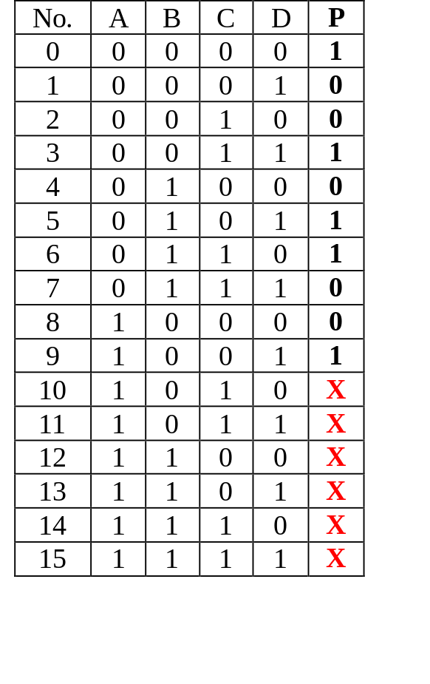
Don’t-care Conditions
In certain problems, some outputs are not specified.
These outputs can be either ‘1’ or ‘0’.
They are called don’t-care conditions, denoted by X (or sometimes, d).
Example: An odd parity generator for BCD code which has 6 unused combinations.

Slide 23
Don’t-care Conditions
Don’t-care conditions can be used to help simplify Boolean expression further in K-maps.
They could be chosen to be either ‘1’ or ‘0’, depending on which gives the simpler expression.

Slide 24
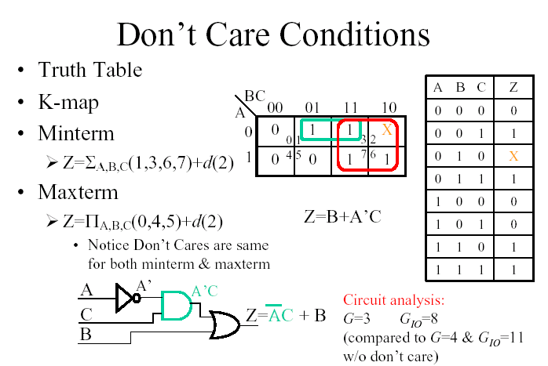

Slide 25
Examples
Example #3 (with don’t cares):
f(A,B,C,D) = ∑ m(2,8,10,15) + ∑ d(0,1,3,7)
A
AB
CD
00 01 11 10
00
01
11
10
X
1
Fill in the 1’s and X’s.
X
D
X
X
1
C
1
1
B

Slide 26
Examples
Example #3 (with don’t cares):
f(A,B,C,D) = ∑ m(2,8,10,15) + ∑ d(0,1,3,7)
A
AB
Do we need to have an additional term A'.B' to cover the 2 remaining x’s?
No, because all the 1’s (minterms) have been covered.
CD
00 01 11 10
00
01
11
10
X
1
X
D
X
X
1
C
1
1
B
f(A,B,C,D) = B'.D' + B.C.D

Slide 27
Examples
Simplify the expression using K-map
f(A,B,C,D) = Σ m(1,3,7,11,15) + d(0,2,5)
From K-map,
f = CD+A’D

Slide 28
Examples
Simplify the following functions using a K-map
f(x,y,z) = x’z’ + y’
d(x,y,z) = yz+xy
f = 1

Slide 29
References
[1]. M. M. Mano, Digital logic and computer design, 5th ed., Pearson Prentice Hall, 2013.
[2]. M. M. Mano and M. D. Ciletti, Digital design, 5th ed., Pearson Prentice Hall, 2013.

